Slide 1
Lesson 4
Aggregate Queries

Slide 2
Implementing Aggregate Queries
Aggregate functions allow you to apply calculations on values in a column
GROUP BY clause allows you to provide aggregate on subsets of the data
Aggregate functions perform calculations on a set of data and return a scalar (single) value

Slide 3
Aggregate Functions
AVG returns the average of all values in the data set.
use JOB_PORTAL_DB;
select AVG(Current_Salary) As 'Average Salary'
from [dbo].[Applicant_Profiles];
select AVG(Current_Salary) As 'Average Salary' from [dbo].[Applicant_Profiles]
WHERE City_Town = N'Toronto';

Slide 4
CHECKSUM_AGG returns the checksum of all values in the data set
CHECKSUM_AGG ([ ALL | DISTINCT ] int_expression)
USE JOB_PORTAL_DB
GO
select CHECKSUM_AGG(CAST(Current_Salary AS INT)) from [dbo].[Applicant_Profiles];

Slide 5
COUNT returns the number items in a group
COUNT(*) returns the number of rows in the set, including NULLs
COUNT DISTINCT returns the number of unique non-NULL values in the data set
COUNT ({[[ALL | DISTINCT] expression] | *})
USE JOB_PORTAL_DB
GO
select COUNT(ALL [Applicant])
FROM [dbo].[Applicant_Job_Applications]
select COUNT(DISTINCT [Applicant])
FROM [dbo].[Applicant_Job_Applications]

Slide 6
COUNT_BIG works the same as COUNT, but it returns the bigint data type
MAX/MIN returns the highest/lowest value in the data set for numeric and character-based fields.
MAX ([ALL | DISTINCT] expression)
USE JOB_PORTAL_DB;
GO
SELECT MAX([Current_Salary])
FROM [dbo].[Applicant_Profiles];

Slide 7
SUM returns the total of the values in the data set. Use ALL or DISTINCT to produce either the sum of all values or only distinct values in the data set.
SUM ([ALL | DISTINCT] expression)

Slide 8
STDEV returns the statistical standard deviation of the values in the data set
STDEVP returns the statistical standard deviation for the population of the values in the data set
VAR returns the statistical variance of the values in the data set
VARP returns the statistical variance for the population of the values in the data set

Slide 9
NULL values are ignored for all the aggregate functions. It is important to understand this so that you can verify the data is being properly interpreted.
Important to remember Null is not 0

Slide 10
GROUP BY Clause
When an aggregate function is included in the SELECT clause, all other expressions in the SELECT clause must either be aggregate functions or included in a GROUP BY clause.
The GROUP BY clause allows you to define subtotals for the aggregate data.

Slide 11
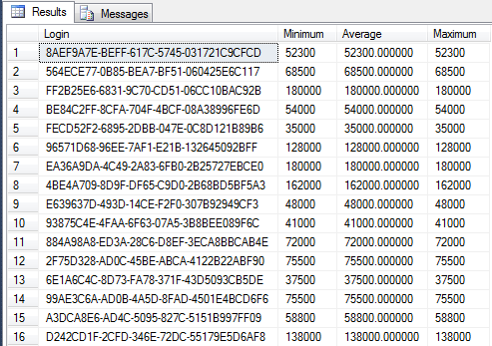
Select
[Login],
MIN([Current_Salary]) As 'Minimum',
AVG([Current_Salary]) As 'Average',
MAX([Current_Salary]) As 'Maximum'
From
[dbo].[Applicant_Profiles]
Where
Country_Code = N'USA'
Group By
[Login];

Slide 12
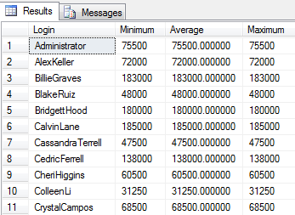
As previous but including Login name
Select
SL.[Login],
MIN([Current_Salary]) As 'Minimum',
AVG([Current_Salary]) As 'Average',
MAX([Current_Salary]) As 'Maximum'
From
[dbo].[Applicant_Profiles] As AP INNER JOIN
[dbo].[Security_Logins] AS SL ON AP.Login = SL.ID
Where
Country_Code = N'USA'
Group By
SL.[Login];

Slide 13
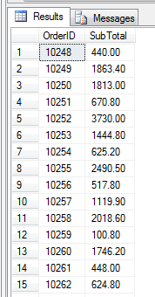
Example: The total for each OrderID from the OrderDetails table.
USE TSQL2012 GO SELECT OrderID,
SUM(UnitPrice * qty) AS SubTotal
FROM Sales.OrderDetails
GROUP BY OrderID
ORDER BY OrderID;

Slide 14
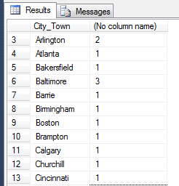
Number of applicants for each City from the Applicant_Profiles table
USE JOB_PORTAL_DB GO
Select
City_Town,
Count(City_Town)
From dbo.Applicant_Profiles
Group By City_Town
Order By City_Town;

Slide 15
Using the HAVING Clause
The HAVING clause allows you to filter based on the results of the calculations performed by the aggregate functions.

Slide 16
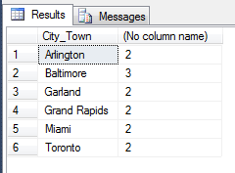
USE JOB_PORTAL_DB
GO
Select
City_Town,
Count(City_Town)
From
dbo.Applicant_Profiles
Group By
City_Town
Having
Count(City_Town) >= 2
Order By
City_Town;

Slide 17
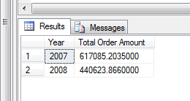
USE TSQL2012
GO
SELECT DATEPART(yyyy,O.OrderDate) AS 'Year',
SUM((unitprice * qty)*(1-discount)) As 'Total Order Amount'
FROM Sales.Orders AS O Left Join Sales.OrderDetails AS OD
ON O.orderid = OD.orderid
GROUP BY DATEPART(yyyy,O.OrderDate)
HAVING DATEPART(yyyy,O.OrderDate) >= '2007'
ORDER BY DATEPART(yyyy,O.OrderDate)

Slide 18
OVER function
The benefits of using OVER is that unlike grouped queries, it does not hide the detail — it returns a row for every underlying query’s row

Slide 19
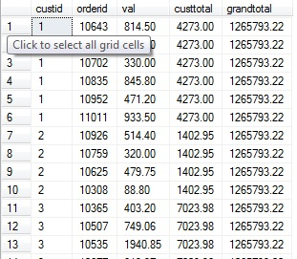
SELECT custid, orderid, val,
SUM(val) OVER(PARTITION BY custid) AS custtotal,
SUM(val) OVER() AS grandtotal
FROM Sales.OrderValues;

Slide 20
Ranking Functions
These are functions that allow us to include numeric columns in our result sets where the value in the column reflects the “rank” of the row
ROW_NUMBER
RANK
DENSE_RANK
NTILE

Slide 21
ROW_NUMBER() OVER ([<partition_by_clause>] <order_by_clause>)
RANK() OVER ([<partition_by_clause>]
<order_by_clause>)
DENSE_RANK() OVER ([<partition_by_clause>]
<order_by_clause>)
NTILE(integer_expression) OVER ([<partition_by_clause>]<order_by_clause>)

Slide 22
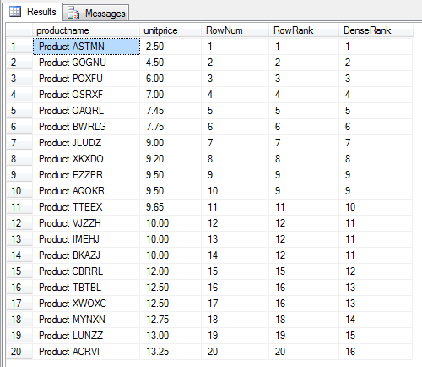
SELECT TOP 20 [productname], [unitprice]
,ROW_NUMBER() OVER(ORDER BY unitprice) AS RowNum
,RANK() OVER(ORDER BY unitprice) AS RowRank
,DENSE_RANK() OVER(ORDER BY unitprice) AS DenseRank
FROM [Production].[Products]

Slide 23
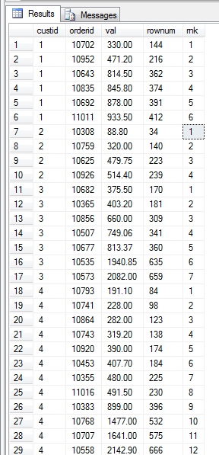
SELECT custid, orderid, val,
ROW_NUMBER() OVER(ORDER BY val) AS rownum,
RANK() OVER(partition BY custid ORDER BY val) AS rnk
FROM Sales.OrderValues;

Slide 24
NTILE
NTILE function generates numbers by dividing the rows into a given number of groups based on the total number of rows (or the number of rows in the partition if the <partition_by_clause> is used)
NTILE (integer_expression) OVER ([<partition_by_clause>] <order_by_clause>)

Slide 25
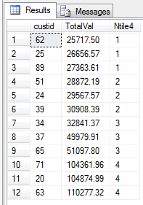
SELECT C.custid, C.TotalVal, NTILE(4) OVER (ORDER BY C.TotalVal) As Ntile4
FROM
(SELECT custid, SUM(val) As TotalVal
FROM Sales.OrderValues
GROUP BY custid
HAVING SUM(val) > 25000) As C;

